Slide 1

Loco-Melhoc
Team Pegasus

Slide 2


Problem statement
Predict the best-suited location for restaurants, based on geo-location data and visualize on maps.

Slide 3

Product Description
The product basically works on the principle of demand and need basis.
The web application provides with the prime location's visualization on a map of the area for ease, with the provided data from the user side.
The web app provides you a greater ease to find the desired prime location within a minimal time consumption.
The product can be used by any person irrespective of the age and other distinguishing factors

Slide 4
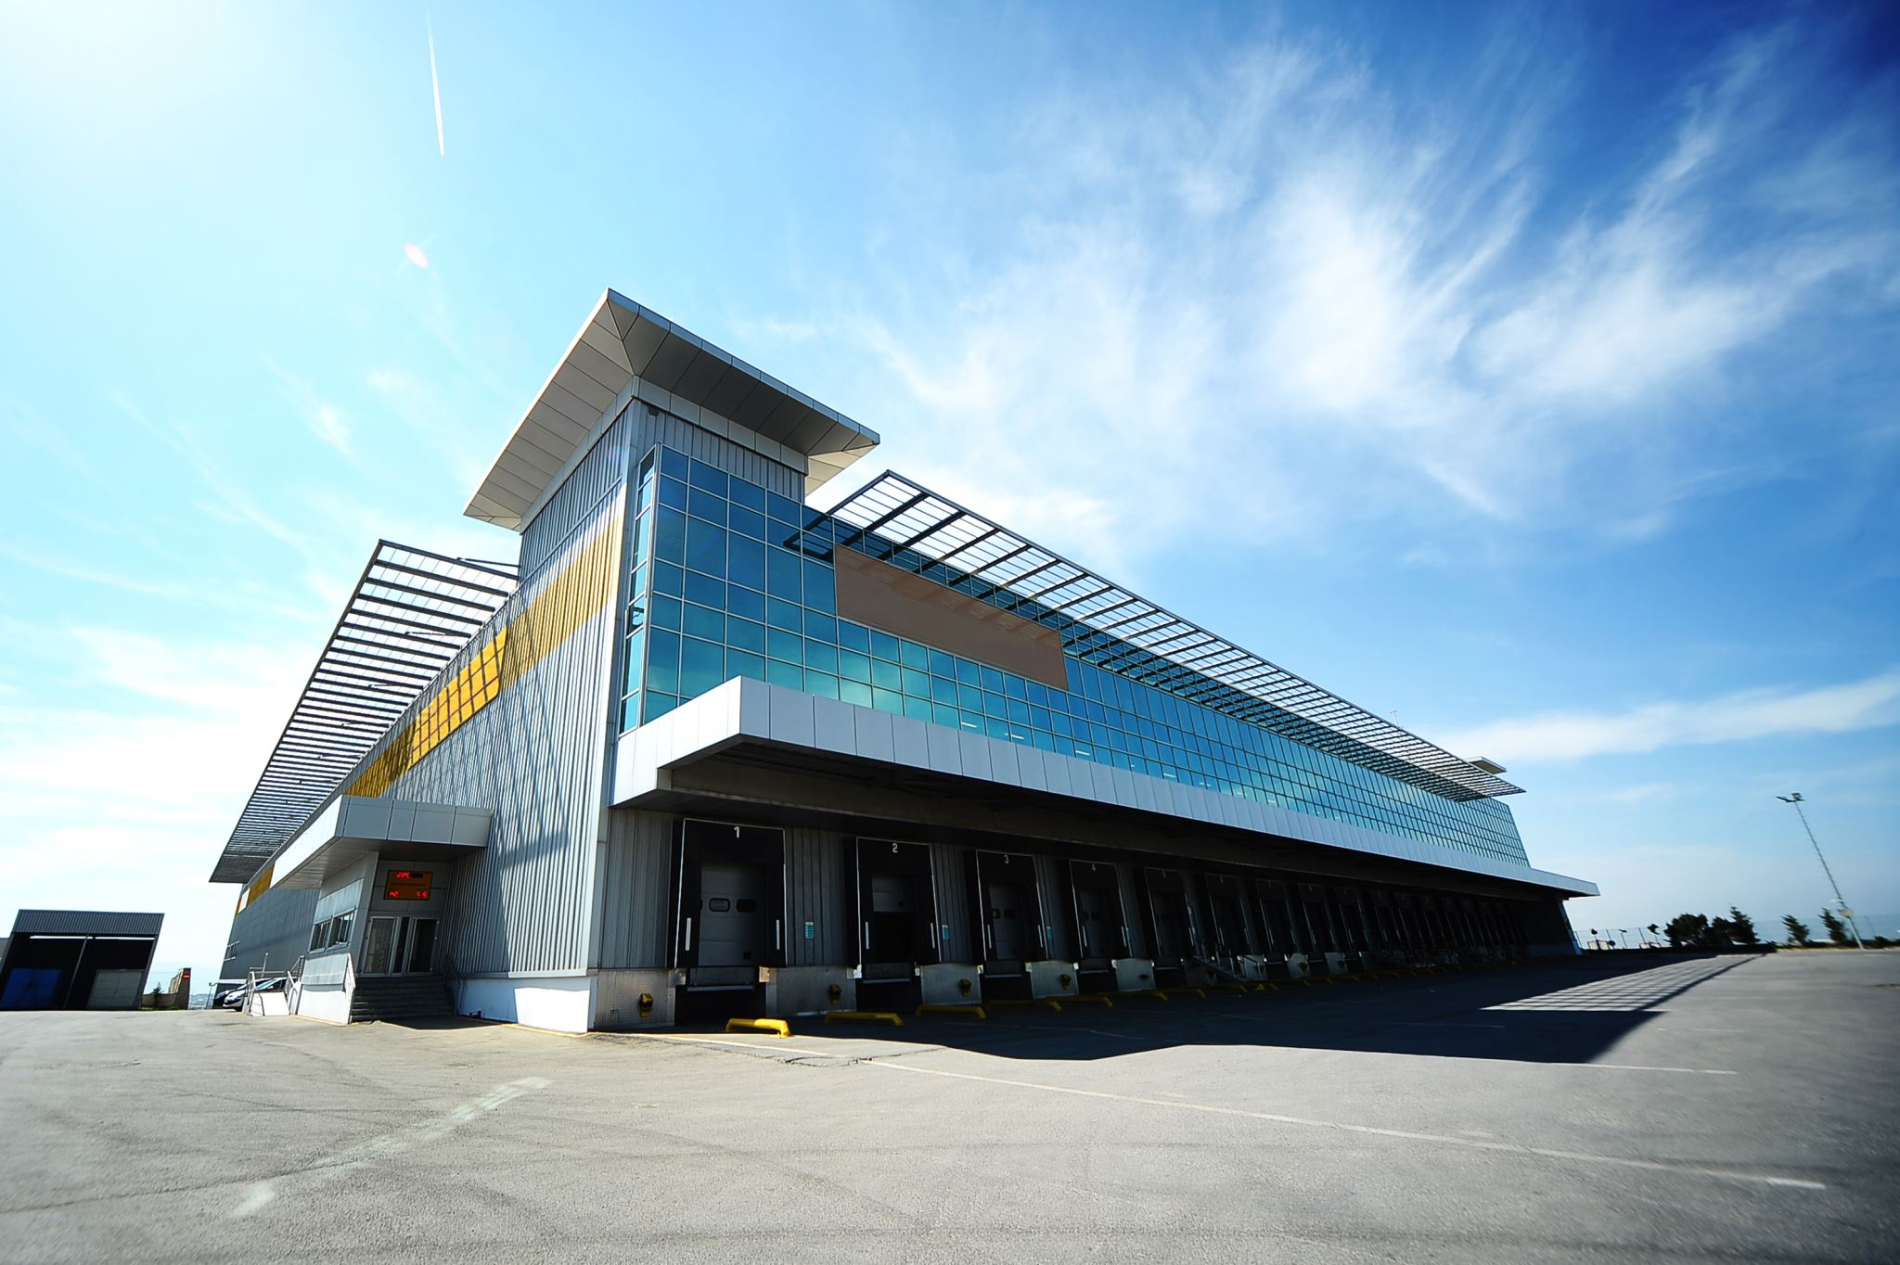
What is loco-Malhoc
Classifying as if the location is good or bad in Delhi NCR location.
If the location is bad it suggests a better location for the restaurants.

Slide 5




Tech stack
Django
Python
Html,css
JavaScript

Slide 6

Future scope
Improve
Improve with foot fall
Ease
Ease of access.
Figure out
Figure out a way to use routing as a training component in future model.

Slide 7


